Slide 1


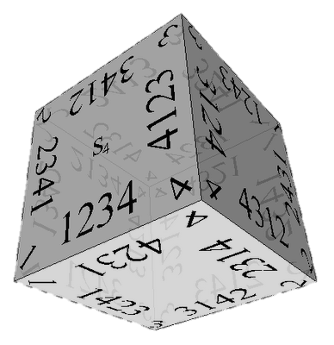

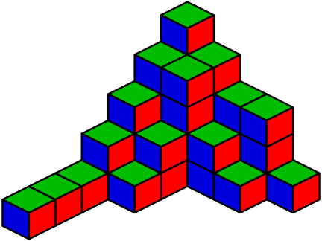

Combinatorial Algorithms
Generating Permutations, Variations, Combinations, …
Combinatorial Algorithms
SoftUni Team
Technical Trainers
Software University
http://softuni.bg

Slide 2

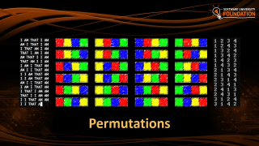
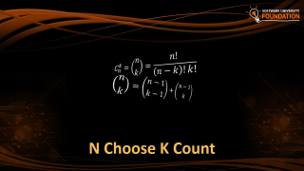

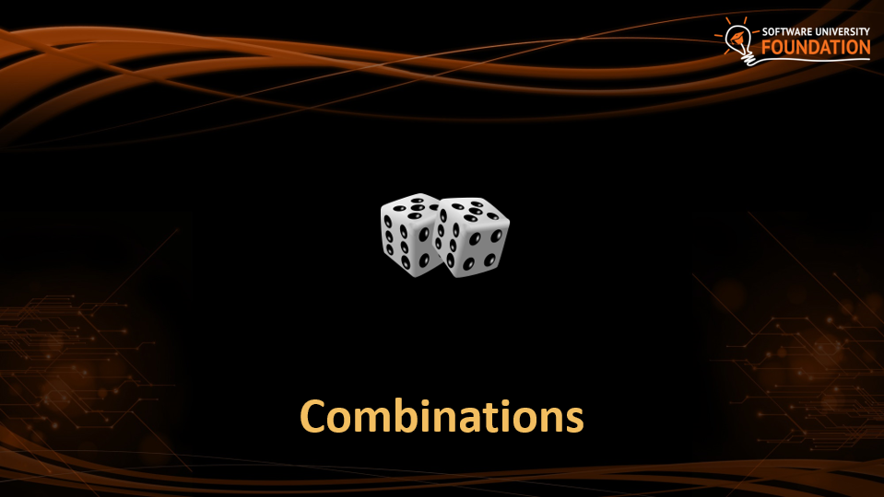
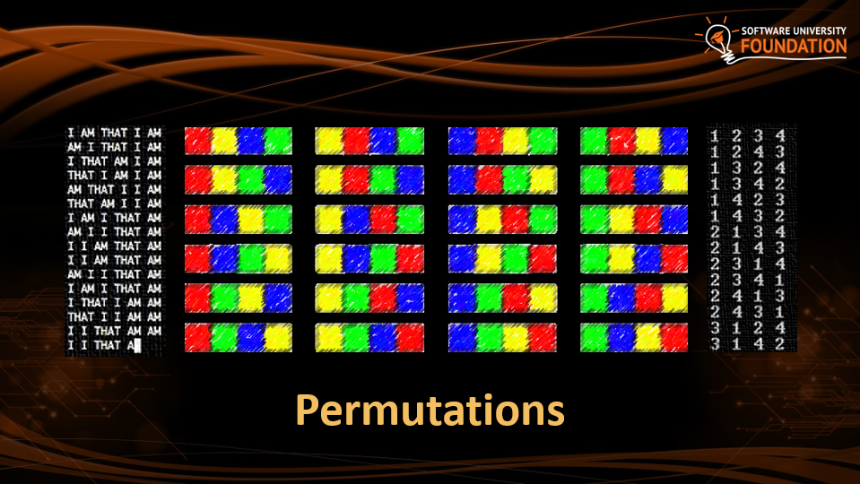


Table of Contents

Slide 3
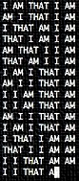
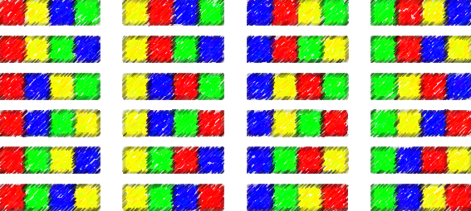
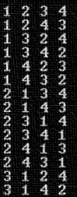
Permutations

Slide 4




Permutations
How to order them in three chairs

Slide 5
Permutations
How to order them in two chairs

Slide 6
Permutations
How to order him in one chairs

Slide 7
Permutations

Slide 8
Permutations
Order A, B and C in all possible ways
A
B
C

Slide 9
Permutations
Order A, B and C in all possible ways
A
B
C
A | B
A | C
B | A
B | C
C | A
C | B

Slide 10
Permutations
Order A, B and C in all possible ways
A
B
C
A | B
A | C
B | A
B | C
C | A
C | B
A | B | C
A | C | B
B | A | C
B | C | A
C | A | B
C | B | A

Slide 11
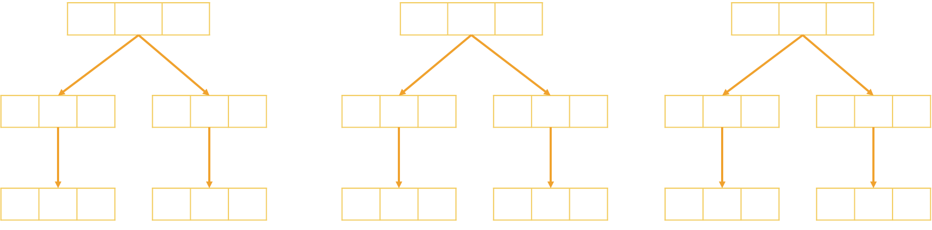
Problem: Generate Permutations
Generates all possible permutations of a given set of elements
You can pick each item only once
A B C
A C B
B A C
B C A
C A B C B A
A B C

Slide 12
Algorithm: Permutations
Algorithm Permute(index) to generate variations P(n)
Put unused elements 0 … n-1 at position index
Mark/unmark elements as being used
Call Permute(index + 1) to generate the rest of the array
Permute(0)
Permute(1)
Permute(k)
Print();
Stop!
0…n-1 | x | x | x | x
→
y | 0…n-1 | x | x | x
…
(unused)
(unused)
Permute(1)
Permute(2)

Slide 13
Generating Permutations
public static void Gen(int index)
{
if (index >= elements.Length)
Console.WriteLine(string.Join(" ", perm));
else
for (int i = 0; i < elements.Length; i++)
if (!used[i])
{
used[i] = true;
perm[index] = elements[i];
Gen(index + 1);
used[i] = false;
}
}
elements = new int[n];
used = new bool[n];
Permute(0);

Slide 14
Permutations Count
Order A, B and C in all possible ways
How many ways are there?
A | B | C
3
2
1
n! = 3!
6 possible ways

Slide 15
Problem: Optimize Permutations
Generates all possible permutations of a given set of elements
Without using extra memory
A B C
A C B
B A C
B C A
C A B C B A
A B C

Slide 16
Permutations: Swap Algorithm

Slide 17
Permutations: Swap Algorithm

Slide 18
Permutations: Swap Algorithm

Slide 19



Permutations: Swap Algorithm

Slide 20
Permutations: Swap Algorithm

Slide 21
Permutations: Swap Algorithm
Swap to origin on the way back

Slide 22
Permutations: Swap Algorithm

Slide 23
Permutations: Swap Algorithm

Slide 24
Permutations: Swap Algorithm
Swap to origin on the way back

Slide 25
Permutations: Swap Algorithm
Swap to origin on the way back

Slide 26
Permutations: Swap Algorithm

Slide 27
Permutations: Swap Algorithm

Slide 28
Permutations: Swap Algorithm

Slide 29
Permutations: Swap Algorithm

Slide 30
Problem: Optimize Permutations
Generates all possible permutations of a given set of elements
Without using extra memory
A B C
A C B
B A C
B C A
C A B C B A
A B C

Slide 31
Generating Permutations
public static void Gen(int index)
if (index >= set.Length)
Console.WriteLine(string.Join(" ", set));
else
Gen(index + 1);
for (int i = index + 1; i < elements.Length; i++)
{
Swap(index, i);
Gen(index + 1);
Swap(index, i);
}
}
elements = new int[n];
Permute(0);

Slide 32
Problem: Permutations with Repetition
What about array = new int[] { A, B, B }
By definition: permutations { A, B', B'' } == { A, B'', B' }
Generate all permutations from a multi-set
A B B
B A B
B B A
A B B

Slide 33
Solution: Permutations with Repetition
public static void Gen(int index)
if (index >= set.Length)
Console.WriteLine(string.Join(" ", set));
else
HashSet<int> swapped = new HashSet<int>();
for (int i = index; i < elements.Length; i++) {
if (!swapped.Contains(elements[i])) {
Swap(index, i);
Gen(index + 1);
Swap(index, i);
swapped.Add(elements[i]);
}
}
}
elements = new int[n];
Permute(0);

Slide 34
Optimized: Permutations with Repetition
Algorithm PermRep(s, e) permutes the items [s … e]
Exchange the item at positions l = k … n-2 with items at l … n-1
Call PermRep(l + 1) to permute the rest of the array
PermRep(0, n-1)
PermRep(2, n-1)
PermRep(n-1, n-1)
s
l
s
l
Stop!
→
…
y | x | l | x | x | x
z | y | x | l | x | x
PermRep(l+1, n-1)
PermRep(l+1, n-1)
More info: http://hardprogrammer.blogspot.bg/2006/11/permutaciones-con-repeticin.html

Slide 35
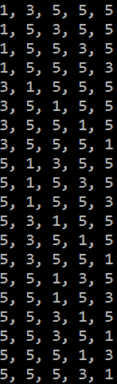
Generating Permutations with Repetition
static void PermuteRep(int[] arr, int start, int end)
{
Print(arr);
for (int left = end - 1; left >= start; left--)
{
for (int right = left + 1; right <= end; right++)
if (arr[left] != arr[right])
{
Swap(ref arr[left], ref arr[right]);
PermuteRep(arr, left + 1, end);
}
var firstElement = arr[left];
for (int i = left; i <= end - 1; i++)
arr[i] = arr[i + 1];
arr[end] = firstElement;
}
}
var arr = new int[] {3, 5, 1, 5, 5};
Array.Sort(arr);
PermuteRep(arr, 0, arr.Length-1);

Slide 36

Permutations with Repetition Count
Order A, B and B in all possible ways
How many ways are there?
A | B | B
$\frac{n!}{s1!s2!..sk!}$ = $\frac{3!}{2!1!}$
3 different ways

Slide 37

Permutations
Live Exercises in Class (Lab)

Slide 38
Variations

Slide 39



Variations
Not enough chairs

Slide 40
Variations

Slide 41


Variations

Slide 42

Variations

Slide 43
Variations

Slide 44
Variations

Slide 45
Variations

Slide 46
Variations

Slide 47
Variations

Slide 48
Variations

Slide 49
Variations
Order A, B and C in all possible ways int k slots
Pick each item only once
A
B
C

Slide 50
Variations
Order A, B and C in all possible ways int k slots
Pick each item only once
A
B
C
A | B
A | C
B | A
B | C
C | A
C | B

Slide 51
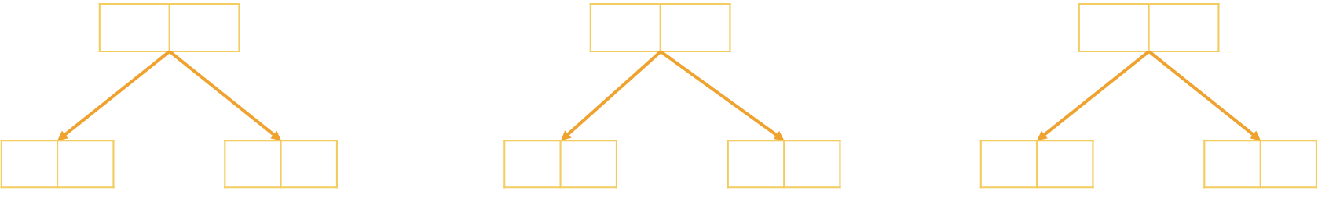
Problem: Generate Variations
Generates all possible variations of k from a set of elements
You can pick an item once
A B
A C
B A
B C
C A
C B
A B C
2

Slide 52
Generating Variations
public static void Gen(int index)
{
if (index >= k)
Console.WriteLine(string.Join(" ", vari));
else
for (int i = 0; i < elements.Length; i++)
if (!used[i])
{
used[i] = true;
vari[index] = elements[i];
Gen(index + 1);
used[i] = false;
}
}
elements = new int[n];
vari = new int[k]
used = new bool[n];
Permute(0);

Slide 53

Variations Count
Order two from A, B, C and D in all possible ways
How many ways are there?
A | B | C | D
4
3
Multiply
$\frac{n!}{(n−k)!}$ = $\frac{4!}{2!}$
12 different ways

Slide 54
Variations with Repetitions
Order A, B and C in all possible ways into k slots
You can pick an item multiple times
A
B
C
A | A
A | B
B | A
B | B
C | A
C | B
A | C
B | C
C | C

Slide 55
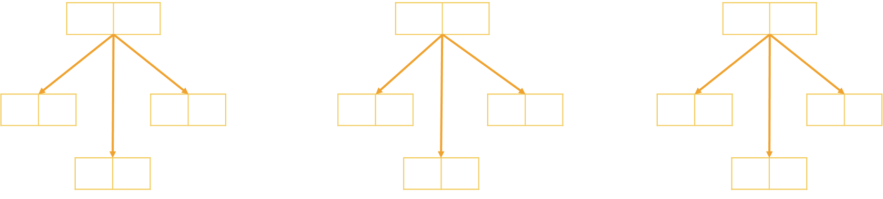
Problem: Generate Variations with Reps
Generates all possible variations of a given elements
You can pick an item multiple times
A A
A B
A C
B A B B
B C
C A
C B C C
A B C
2

Slide 56
Generating Permutations
public static void Gen(int index)
{
if (index >= k)
Console.WriteLine(string.Join(" ", variation));
else
{
for (int i = 0; i < n; i++)
{
variation[index] = elements[i];
Gen(index + 1);
}
}
elements = new int[n];
variation = new int[k]
Permute(0);

Slide 57
Variations with Reps: Iterative Algorithm
Generating the variations for n = 3 and k = 2
A | A
B | A
C | A
A | B
B | B
C | B
A | C
B | C
C | C

Slide 58
Variations with Reps: Iterative Algorithm
while (true)
{
Print(arr);
int index = k - 1;
while (index >= 0 && arr[index] == n-1)
index--;
if (index < 0)
break;
arr[index]++;
for (int i = index + 1; i < k; i++)
arr[i] = 0;
}
int n = 5;
int k = 3;
int[] arr = new int[k];
(0, 0, 0)
(0, 0, 1)
…
(4, 4, 2)
(4, 4, 3)
(4, 4, 4)

Slide 59

Variations Count
Order two from A, B, C and D in all possible ways
How many ways are there?
A | B | C | D
4
4
Multiply
$n$^{k} = $42$
16 different ways

Slide 60

Combinations

Slide 61





Combinations
Pick two to hang out

Slide 62
Combinations

Slide 63
Combinations

Slide 64
Combinations

Slide 65


Combinations

Slide 66

Combinations

Slide 67
Combinations

Slide 68

Combinations

Slide 69
Combinations

Slide 70

Combinations

Slide 71

Combinations

Slide 72
Combinations
Pick two form A, B and C
Order does not matter
A
B
C
A | B
A | C
B | C

Slide 73
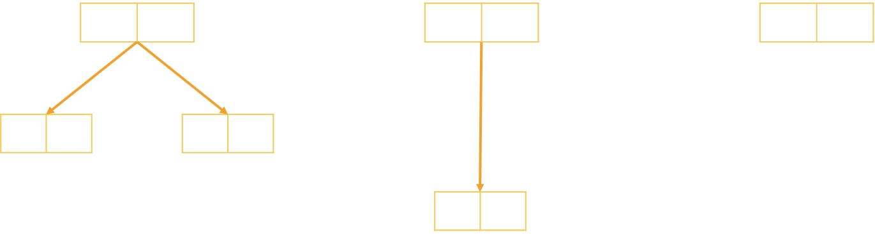
Problem: Generate Combinations
Generates all possible combinations from a given elements
You can pick each item only once
A B
A C
B C
A B C
2

Slide 74
Algorithm: Combinations without Repetition
Algorithm Comb(index, start)
Put the numbers i = start … n-1 at position index
Call Comb(index + 1, i + 1) to generate the rest of the array
Comb(0, start)
Comb(1, start)
Comb(k, start)
Print();
Stop!
i | x | x | x | x | x | x
→
y | i | x | x | x | x | x
…
Comb(1, i+1)
Comb(2, i+1)

Slide 75
Combinations without Repetition
void Comb(int index, int start)
{
if (index >= k)
{
PrintCombinations();
}
else
for (int i = start; i < n; i++)
{
arr[index] = i;
Comb(index + 1, i + 1);
}
}
int k = 3;
int n = 5;
int[] arr = new int[k];
Comb(0, 0);

Slide 76

Combinations Count
Pick two from A, B, C and D in all possible ways, order does not matter
How many ways are there?
A | B | C | D
4
3
Variations n = 4, k = 2
2
1
Permutations of n = 2
$\frac{n!}{k!\left(n−k\right)! }$ = $\frac{4!}{2!2!}$
6 different ways

Slide 77
Algorithm: Combinations with Repetition
Algorithm Comb(index, start)
Put the numbers i = start … n-1 at position index
Call Comb(index + 1, i) to generate the rest of the array
CombRep(0, start)
CombRep(1, start)
CombRep(k, start)
Print();
Stop!
i | x | x | x | x | x | x
→
y | i | x | x | x | x | x
…
CombRep(1, i)
CombRep(2, i)

Slide 78
Generate Combinations with Repetition
void Comb(int index, int start)
{
if (index >= k)
{
PrintCombinations();
}
else
for (int i = start; i < n; i++)
{
arr[index] = i;
Comb(index + 1, i);
}
}
int k = 3;
int n = 4;
int[] arr = new int[k];
Comb(0, 0);

Slide 79
Variations and Combinations
Live Exercises in Class (Lab)

Slide 80


N Choose K Count

Slide 81

Problem: Combinations Count
How many combinations are there for n = 16, k = 15
Solution:
How many ways to pick 15 items?
Divide by the number of ways in which you can arrange 15 numbers
Possible combinations → 16
$$C_{n}^{k}=\left({n \atop k}\right)=\frac{n!}{\left(n−k\right)!k!}$$
16 * 15 * 14 * … * 2
15 * 14 * 13 * … * 1

Slide 82
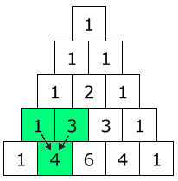

Pascal's Triangle
Each node → how many ways are there to reach it?
Quickly find N choose K count
Go down to row n (the top row is 0)
Move along k places to the right
The value there is your answer
$$C_{n}^{k}=\left({n \atop k}\right)=\frac{n!}{\left(n−k\right)!k!}$$

Slide 83
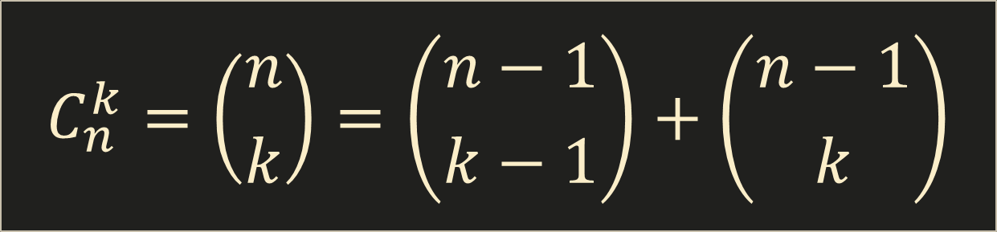
Binomial Coefficients: Calculation
$$C_{n}^{k}=\left({n \atop k}\right)=\left({n−1 \atop k−1}\right)+\left({n−1 \atop k}\right)$$
Base cases:
if k > n → 0
if k == 0 → 1
if k == n → 1

Slide 84

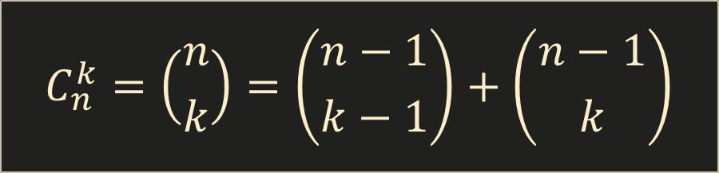
Binomial Coefficients: Calculation
decimal Binom(int n, int k)
{
if (k > n)
return 0;
if (k == 0 || k == n)
return 1;
return Binom(n - 1, k - 1) + Binom(n - 1, k);
}
$$C_{n}^{k}=\left({n \atop k}\right)=\left({n−1 \atop k−1}\right)+\left({n−1 \atop k}\right)$$
This is slow (stay tuned for DP)

Slide 85

Summary
Permutations – Ways to order n elements
Variations – Ways to order k of n elements
Combinations – Ways to choose k of n elements
Pascal's Triangle
Binomial Coefficients () – N choose K Count

